Slide 1
OCCULAR DISEASE RECOGNITION
-Aditya Mukherjee
RA1911003010210

Slide 2
Acknowledgement
I would like to thank Grzegorz Meller for the inspiration to the project

Slide 3
Abstract
Approximately 12 million people every year suffer from eye diseases like macular degeneration, glaucoma, and cataracts
Some of these are not even in detected and if left alone it can be fatal sometimes
The equipment required for the detection can also be costly also weather the doctor remained equipped to decipher is a question too

Slide 4
Thus my answer to this problem statement was to create a Image classifier using pytorch, that is trained on over 2000 images of eye problems and can then help you identify if you have any problem in your eye or not from just a click

Slide 5
Intorduction
Early ocular disease detection is an economic and effective way to prevent blindness caused by diabetes, glaucoma, cataract, age-related macular degeneration (AMD), and many other diseases.
According to World Health Organization (WHO) at present, at least 2.2 billion people around the world have vision impairments, of whom at least 1 billion have a vision impairment that could have been prevented.
Rapid and automatic detection of diseases is critical and urgent in reducing the ophthalmologist’s workload and prevents vision damage of patients.
Computer vision and deep learning can automatically detect ocular diseases after providing high-quality medical eye fundus images.

Slide 6
Thus, this projects works on creating an accurate and well to do Project in the eye funds recognition

Slide 7
Literature Survey
AI/ML Use case
To start the project, the first step was to research the use cases of AI/ML. As I had selected on doing a project on AI/ML I had to go thought various articles and this article by Forbes(https://www.forbes.com/sites/bernardmarr/2016/09/30/what-are-the-top-10-use-cases-for-machine-learning-and-ai/?sh=3715ae6f94c9 )gave me various different ideas on how to and where AI/ML were used and I selected Health care as my topic

Slide 8
Image Segmentation techniques
In this paper(https://arxiv.org/pdf/2102.07978.pdf ), it investigates evaluation of networks of increasing depth using an architecture with very small (3x3) convolution filters, which shows that a significant improvement on the prior-art configurations can be achieved by pushing the depth to 16-19 weight layers. But as this paper is a bit outdated a more robust CNN could have been developed with a better architecture.
After going through this paper,it came to light there was a place where it could have been improved in providing more depth in layers and also bigger convolution layers.

Slide 9
Dataset analysis
In this paper(https://arxiv.org/pdf/2102.07978.pdf ),the data set used was ODIR. After going through kaggle there were various data sets that were available . But All the data-sets while having good images did not have the volume that the ODIR data-set had and as for training and accuracy of the CNN model accuracy is an important factor and thus it was decided that the ODIR data-set would be used.

Slide 10
Model Selection
In this paper(https://arxiv.org/pdf/1409.1556v6.pdf ),its is clearly visible they have used predefined models that are available in the net to train and have also combined various data-sets and passed on to doctors for classification,But as we do not have the same resources available we have to use a more student friendly approach.For this we have created a more simpler and customize able model with a more student friendly pipeline ,where the data-set can be pre-processed in a more friendly

Slide 11
Dataset
Ocular Disease Intelligent Recognition (ODIR) is a structured ophthalmic database of 5,000 patients with age, color fundus photographs from left and right eyes, and doctors’ diagnostic keywords from doctors.
This dataset is meant to represent the ‘‘real-life’’ set of patient information collected by Shanggong Medical Technology Co., Ltd. from different hospitals/medical centers in China.
In these institutions, fundus images are captured by various cameras in the market, such as Canon, Zeiss, and Kowa, resulting in varied image resolutions.
Annotations were labeled by trained human readers with quality control management. They classify patients into eight labels including normal (N), diabetes (D), glaucoma (G), cataract (C), AMD (A), hypertension (H), myopia (M), and other diseases/abnormalities (O).

Slide 12
After preliminary data exploration I found the following main challenges of the ODIR dataset:
Highly unbalanced data. Most images are classified as normal (1140 examples), while specific diseases like for example hypertension have only 100 occurrences in the dataset.
The dataset contains multi-label diseases because each eye can have not only one single disease but also a combination of many.
Images labeled as “other diseases/abnormalities” (O) contain images associated to more than 10 different diseases stretching the variability to a greater extent.
·Very big and different image resolutions. Most images have sizes of around 2976x2976 or 2592x1728 pixels.

Slide 13
Certain data pre processing was done on the images to help overcome this problems
This was done using opencv module
As the number of images was less , Image augmentation techniques was used to help increase the test metrics
The were done in the following file
https://colab.research.google.com/github/adityamukherjee42/Ocular-Disease-Recognition-/blob/main/Occular_disease_preprocessing.ipynb#scrollTo=qK0DU--zmv6u

Slide 14
Building Convolutional Neural Network
In deep learning, a convolutional neural network (CNN) is a class of deep neural networks, most commonly applied to analyzing visual imagery.
Input layer takes 250x250 RGB images. The first 2D convolution layer shifts over the input image using a window of the size of 3x3 pixels to extract features and save them on a multi-dimensional array, in my example number of filters for the first layer equals 64,
And to reduce overfitting and computation time , a maxpool layer was used so the cube or the image size will be (50, 50, 32)

Slide 15
Similary more layers were created with similar parameters
After each convolution layer, a rectified linear activation function (ReLU) is applied. Activation has the authority to decide if neuron needs to be activated or not measuring the weighted sum. ReLU returns the value provided as input directly, or the value 0.0 if the input is 0.0 or less. Because rectified linear units are nearly linear, they preserve many of the properties that make linear models easy to optimize with gradient-based methods. They also preserve many of the properties that make the linear model generalize well

Slide 16
And A Dropout layer with 60% percent drop out rate was created to create more varations and avoid overfitting

Slide 17
Training
For Training , K-Fold cross validation technique was used
Cross-validation is a resampling procedure used to evaluate machine learning models on a limited data sample.
The procedure has a single parameter called k that refers to the number of groups that a given data sample is to be split into. As such, the procedure is often called k-fold cross-validation. When a specific value for k is chosen, it may be used in place of k in the reference to the model, such as k=10 becoming 10-fold cross-validation

Slide 18

Result metrics

Slide 19
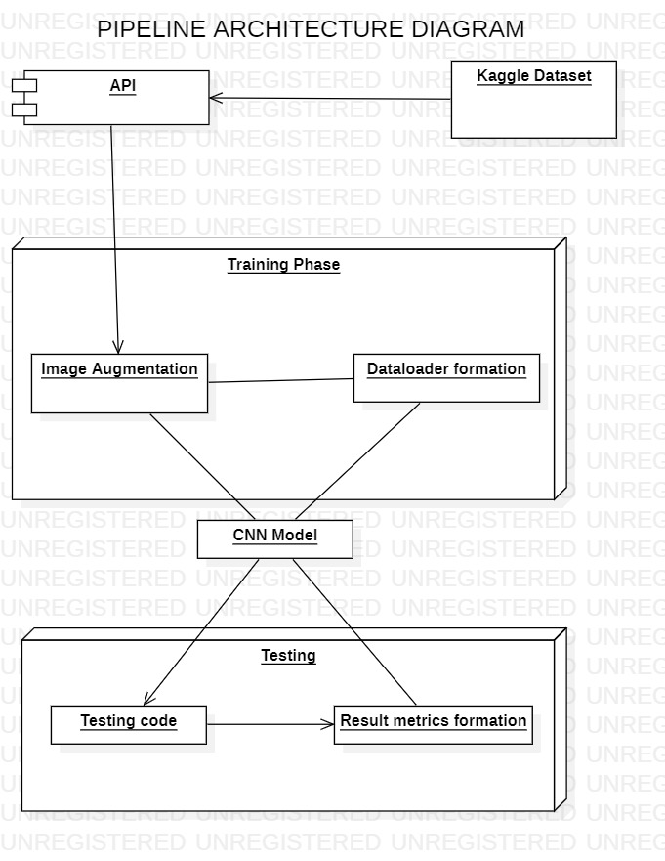

Slide 20
Conclusion
In this new age of Big data, my aim here was to create a universal pipeline using pytorch so that anyone starting off can see this and take it as an inspiration
Also while this pipeline was created , It was kept in mind that that it will be trained again with more points that will result in better accuracy
The usage of this software ,can be widespread.
Medical with machine learning is need of the hour as with insufficient doctors available especially in the village places

Slide 21
The Pandemic has also emphasized the same, The huge loss of life could have been reduced if we had an infrastructure where inaccessible people could have been diagnosed using a mobile app or the net
While Internet is still inaccessible in some areas, the advancement is a necessary in this age
Also with cases like fake doctors or doctors making human errors can be eliminated with the use of Software and technologies like this

Slide 22
Thus,keeping all of this in mind this project was created
Further up gradation like training the model with more images and giving it an frontend and hosting it on the net will be done

Slide 23
Important links
https://colab.research.google.com/drive/17fn_JbMUsWom9Ry74vT8UDa8m301uxyF#scrollTo=WywrSAdKGzWw
https://colab.research.google.com/github/adityamukherjee42/Ocular-Disease-Recognition-/blob/main/Occular_disease_preprocessing.ipynb#scrollTo=k5dJoabfhyn4
https://github.com/adityamukherjee42/Ocular-Disease-Recognition-

Slide 24
Stack used
Pytorch-For creating CNN
Opencv-For image Augmentation
Streamlit-For frontend
Dataset used
https://www.kaggle.com/kondwani/eye-disease-dataset

Slide 25
Refrence
https://towardsdatascience.com/ocular-disease-recognition-using-convolutional-neural-networks-c04d63a7a2da

Slide 26
THANK YOU

